Slide 1
Encoder-decoder models for machine translation
The encoder steps through the input time steps and encodes the entire sequence into a fixed length vector called a context vector.
Big RNNs trained end-to-end.
Ilya Sutskever, et al. “Sequence to Sequence Learning with Neural Networks” using LSTMs.
Kyunghyun Cho, et al. “Learning Phrase Representations using RNN Encoder–Decoder for Statistical Machine Translation”.
Notes:
Researchers at Google & Montreal develop a new approach for MT
What is NMT?
A large neural network trained end-to-end.
Reads the entire source sentence.
Produces a translation one word at a time.
Advantages
Input sequence, output sequence
Generalization: source-conditioned LMs.
30, 50-gram LMs
Dimensionality reduction: no gigantic PTs or LMs.
Simple beam-search decoder.

Slide 2
Encoder-decoder models for machine translation
The encoder steps through the input time steps and encodes the entire sequence into a fixed length vector called a context vector.
Big RNNs trained end-to-end.
Ilya Sutskever, et al. “Sequence to Sequence Learning with Neural Networks” using LSTMs.
Kyunghyun Cho, et al. “Learning Phrase Representations using RNN Encoder–Decoder for Statistical Machine Translation”.
Notes:
Researchers at Google & Montreal develop a new approach for MT
What is NMT?
A large neural network trained end-to-end.
Reads the entire source sentence.
Produces a translation one word at a time.
Advantages
Input sequence, output sequence
Generalization: source-conditioned LMs.
30, 50-gram LMs
Dimensionality reduction: no gigantic PTs or LMs.
Simple beam-search decoder.

Slide 3
Encoder-decoder models for machine translation
The encoder steps through the input time steps and encodes the entire sequence into a fixed length vector called a context vector.
Big RNNs trained end-to-end.
Ilya Sutskever, et al. “Sequence to Sequence Learning with Neural Networks” using LSTMs.
Kyunghyun Cho, et al. “Learning Phrase Representations using RNN Encoder–Decoder for Statistical Machine Translation”.
Notes:
Researchers at Google & Montreal develop a new approach for MT
What is NMT?
A large neural network trained end-to-end.
Reads the entire source sentence.
Produces a translation one word at a time.
Advantages
Input sequence, output sequence
Generalization: source-conditioned LMs.
30, 50-gram LMs
Dimensionality reduction: no gigantic PTs or LMs.
Simple beam-search decoder.

Slide 4
Encoder-decoder models for machine translation
The encoder steps through the input time steps and encodes the entire sequence into a fixed length vector called a context vector.
Big RNNs trained end-to-end.
Ilya Sutskever, et al. “Sequence to Sequence Learning with Neural Networks” using LSTMs.
Kyunghyun Cho, et al. “Learning Phrase Representations using RNN Encoder–Decoder for Statistical Machine Translation”.
Notes:
Researchers at Google & Montreal develop a new approach for MT
What is NMT?
A large neural network trained end-to-end.
Reads the entire source sentence.
Produces a translation one word at a time.
Advantages
Input sequence, output sequence
Generalization: source-conditioned LMs.
30, 50-gram LMs
Dimensionality reduction: no gigantic PTs or LMs.
Simple beam-search decoder.

Slide 5
Encoder-decoder models for machine translation
The encoder steps through the input time steps and encodes the entire sequence into a fixed length vector called a context vector.
Big RNNs trained end-to-end.
Ilya Sutskever, et al. “Sequence to Sequence Learning with Neural Networks” using LSTMs.
Kyunghyun Cho, et al. “Learning Phrase Representations using RNN Encoder–Decoder for Statistical Machine Translation”.
Notes:
Researchers at Google & Montreal develop a new approach for MT
What is NMT?
A large neural network trained end-to-end.
Reads the entire source sentence.
Produces a translation one word at a time.
Advantages
Input sequence, output sequence
Generalization: source-conditioned LMs.
30, 50-gram LMs
Dimensionality reduction: no gigantic PTs or LMs.
Simple beam-search decoder.

Slide 6
Encoder-decoder models for machine translation
The encoder steps through the input time steps and encodes the entire sequence into a fixed length vector called a context vector.
The decoder steps through the output time steps while reading from the context vector.
Big RNNs trained end-to-end: encoder-decoder.
Ilya Sutskever, et al. “Sequence to Sequence Learning with Neural Networks” using LSTMs.
Kyunghyun Cho, et al. “Learning Phrase Representations using RNN Encoder–Decoder for Statistical Machine Translation”.
Notes:
Researchers at Google & Montreal develop a new approach for MT
What is NMT?
A large neural network trained end-to-end.
Reads the entire source sentence.
Produces a translation one word at a time.
Advantages
Input sequence, output sequence
Generalization: source-conditioned LMs.
30, 50-gram LMs
Dimensionality reduction: no gigantic PTs or LMs.
Simple beam-search decoder.

Slide 7
Encoder-decoder models for machine translation
The encoder steps through the input time steps and encodes the entire sequence into a fixed length vector called a context vector.
The decoder steps through the output time steps while reading from the context vector.
Big RNNs trained end-to-end: encoder-decoder.
Ilya Sutskever, et al. “Sequence to Sequence Learning with Neural Networks” using LSTMs.
Kyunghyun Cho, et al. “Learning Phrase Representations using RNN Encoder–Decoder for Statistical Machine Translation”.
Notes:
Researchers at Google & Montreal develop a new approach for MT
What is NMT?
A large neural network trained end-to-end.
Reads the entire source sentence.
Produces a translation one word at a time.
Advantages
Input sequence, output sequence
Generalization: source-conditioned LMs.
30, 50-gram LMs
Dimensionality reduction: no gigantic PTs or LMs.
Simple beam-search decoder.

Slide 8
Encoder-decoder models for machine translation
The encoder steps through the input time steps and encodes the entire sequence into a fixed length vector called a context vector.
The decoder steps through the output time steps while reading from the context vector.
Big RNNs trained end-to-end: encoder-decoder.
Ilya Sutskever, et al. “Sequence to Sequence Learning with Neural Networks” using LSTMs.
Kyunghyun Cho, et al. “Learning Phrase Representations using RNN Encoder–Decoder for Statistical Machine Translation”.
Notes:
Researchers at Google & Montreal develop a new approach for MT
What is NMT?
A large neural network trained end-to-end.
Reads the entire source sentence.
Produces a translation one word at a time.
Advantages
Input sequence, output sequence
Generalization: source-conditioned LMs.
30, 50-gram LMs
Dimensionality reduction: no gigantic PTs or LMs.
Simple beam-search decoder.

Slide 9
Encoder-decoder models for machine translation
The encoder steps through the input time steps and encodes the entire sequence into a fixed length vector called a context vector.
The decoder steps through the output time steps while reading from the context vector.
Big RNNs trained end-to-end: encoder-decoder.
Generalize well to long sequences.
Small memory footprint.
Simple decoder.
Ilya Sutskever, et al. “Sequence to Sequence Learning with Neural Networks” using LSTMs.
Kyunghyun Cho, et al. “Learning Phrase Representations using RNN Encoder–Decoder for Statistical Machine Translation”.
Notes:
Researchers at Google & Montreal develop a new approach for MT
What is NMT?
A large neural network trained end-to-end.
Reads the entire source sentence.
Produces a translation one word at a time.
Advantages
Input sequence, output sequence
Generalization: source-conditioned LMs.
30, 50-gram LMs
Dimensionality reduction: no gigantic PTs or LMs.
Simple beam-search decoder.

Slide 10
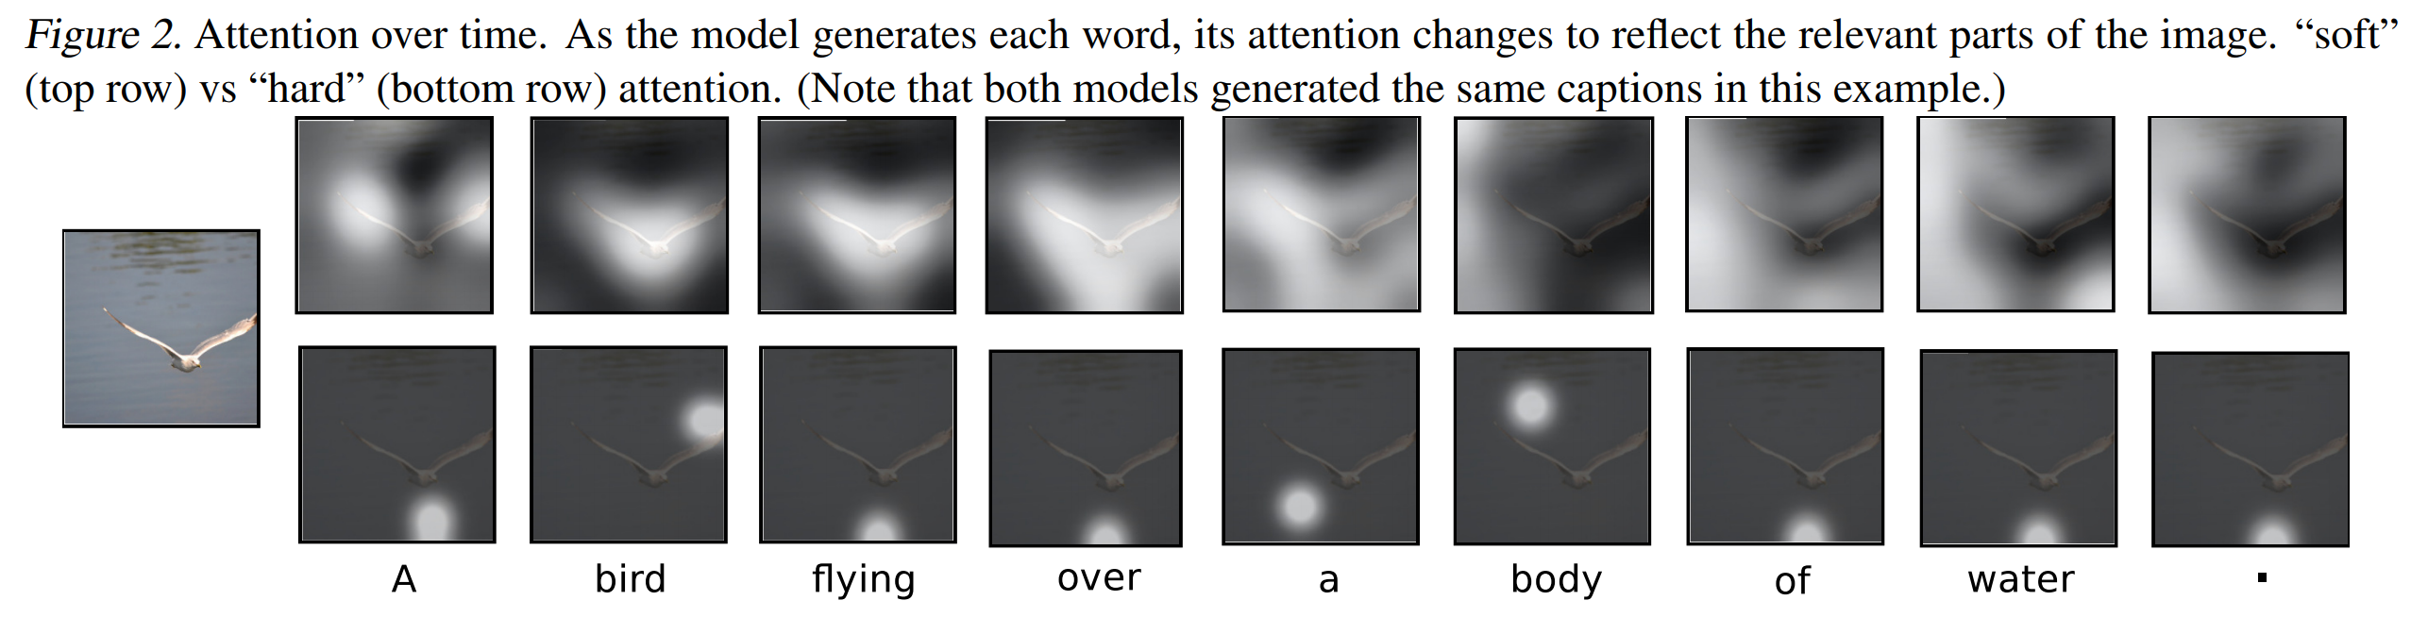
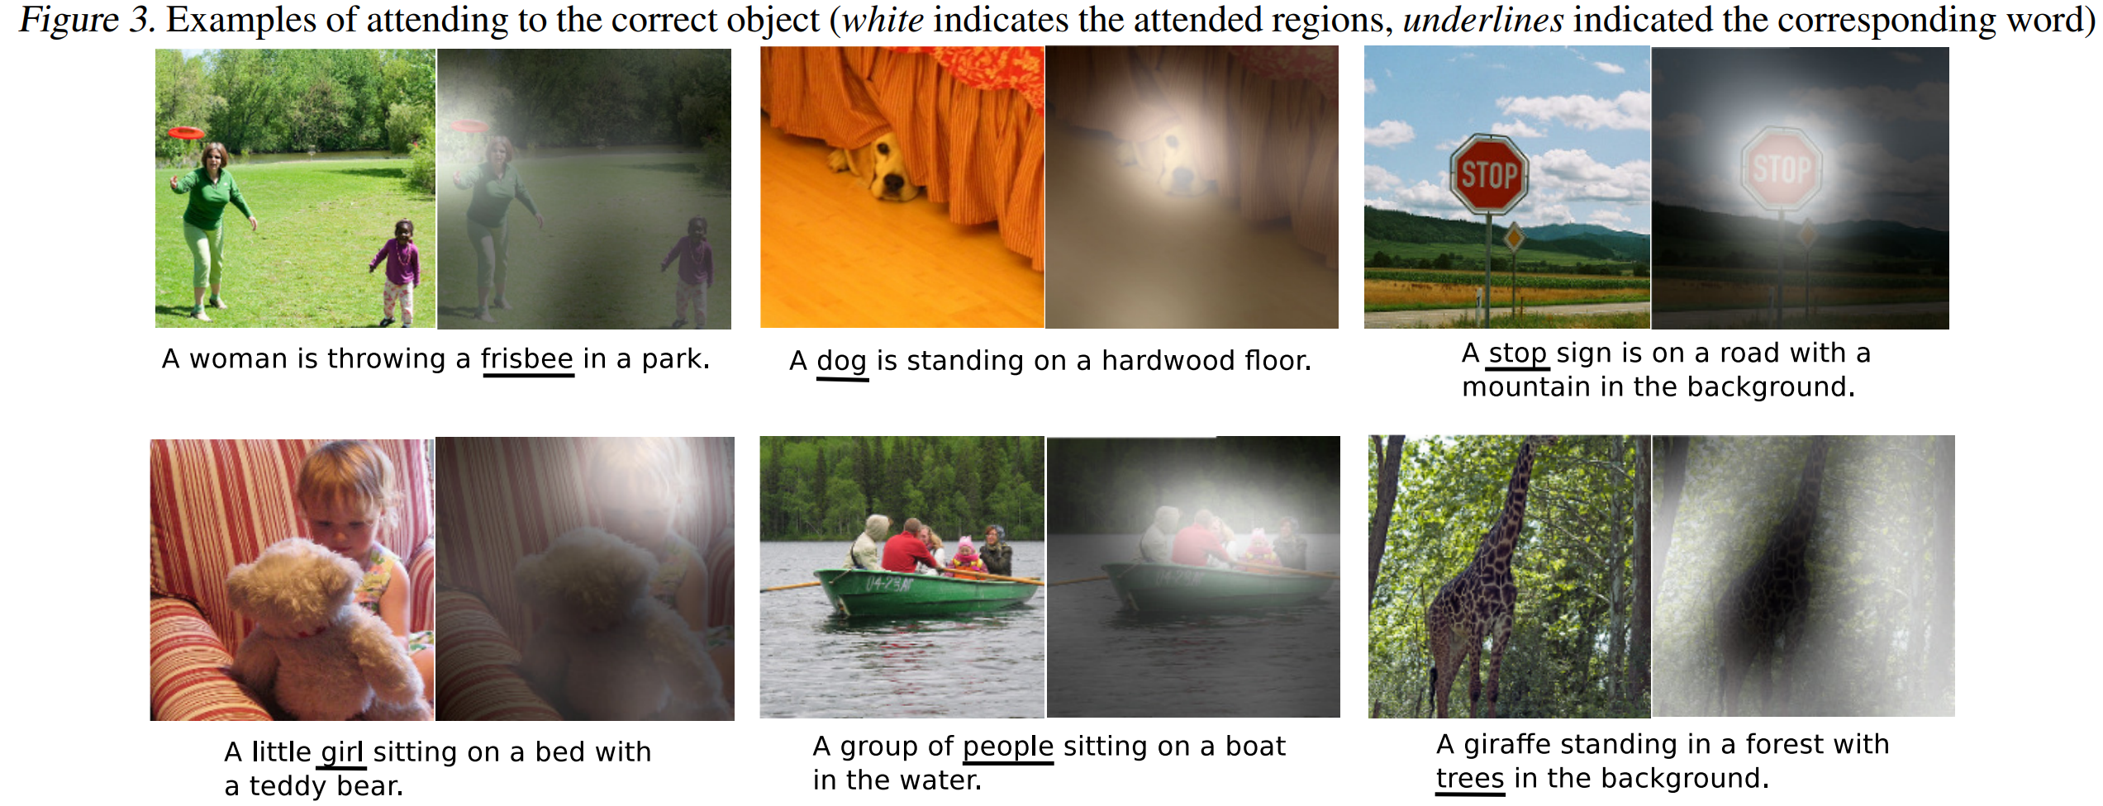
Show, Attend and Tell: Neural Image Caption Generation with Visual Attention. xu15_jmlr

Slide 11
Attention Mechanism
Maintain a memory of source hidden states
Compare target and source hidden states
Able to translate long sentences.
Neural Machine Translation by Jointly Learning to Align and Translate, 2015
Notes:
In caption generation: image /text (Xu et al., ’15).

Slide 12
Attention Mechanism
0.6
Maintain a memory of source hidden states
Compare target and source hidden states
Able to translate long sentences.
Neural Machine Translation by Jointly Learning to Align and Translate, 2015
Notes:
In caption generation: image /text (Xu et al., ’15).

Slide 13
Attention Mechanism
0.6
0.2
Maintain a memory of source hidden states
Compare target and source hidden states
Able to translate long sentences.
Neural Machine Translation by Jointly Learning to Align and Translate, 2015
Notes:
In caption generation: image /text (Xu et al., ’15).

Slide 14
Attention Mechanism
0.6
0.2
0.1
Maintain a memory of source hidden states
Compare target and source hidden states
Able to translate long sentences.
Neural Machine Translation by Jointly Learning to Align and Translate, 2015
Notes:
In caption generation: image /text (Xu et al., ’15).

Slide 15
Attention Mechanism
0.6
0.2
0.1
0.1
Maintain a memory of source hidden states
Compare target and source hidden states
Able to translate long sentences.
Neural Machine Translation by Jointly Learning to Align and Translate, 2015
Notes:
In caption generation: image /text (Xu et al., ’15).

Slide 16
Attention Mechanism
0.6
0.2
0.1
0.1
Maintain a memory of source hidden states
Able to translate long sentences.
f
Neural Machine Translation by Jointly Learning to Align and Translate, 2015
Notes:
In caption generation: image /text (Xu et al., ’15).

Slide 17
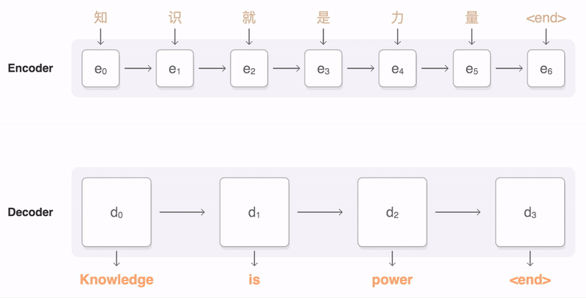
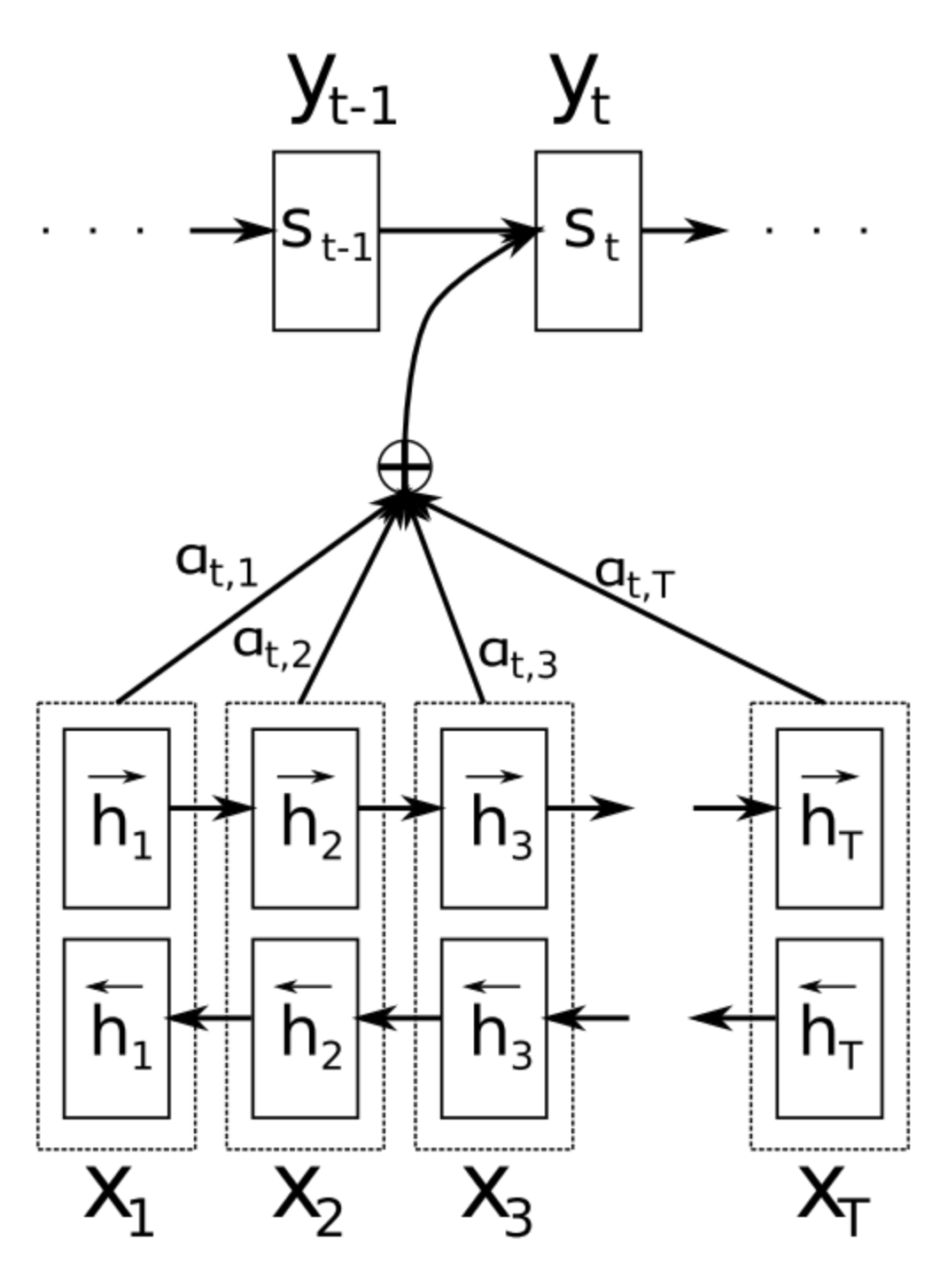
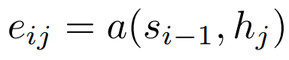
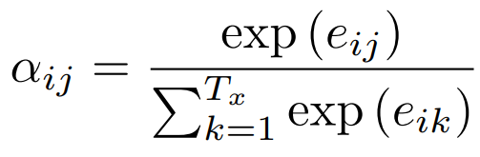
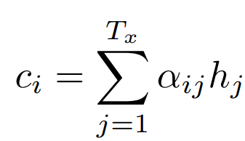
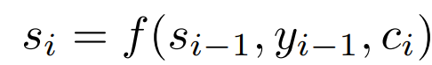
Attention Network
Neural Machine Translation by Jointly Learning to Align and Translate, 2015

Slide 18
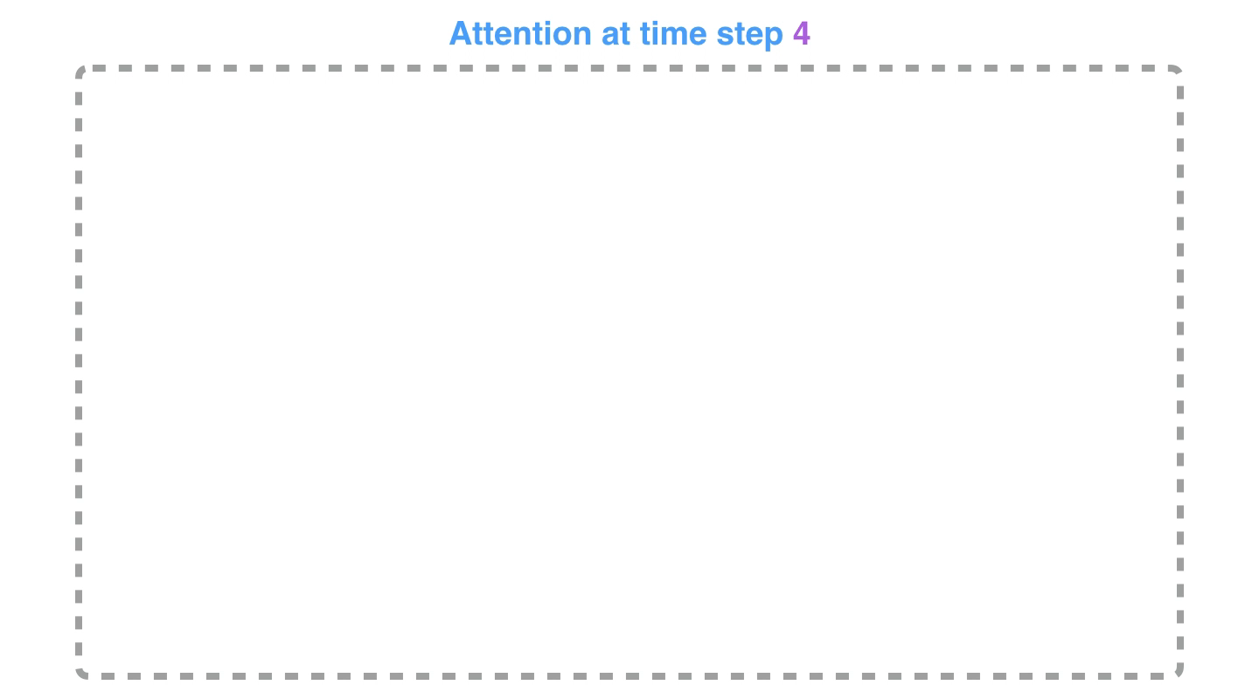
Neural Machine Translation by Jointly Learning to Align and Translate, 2015

Slide 19
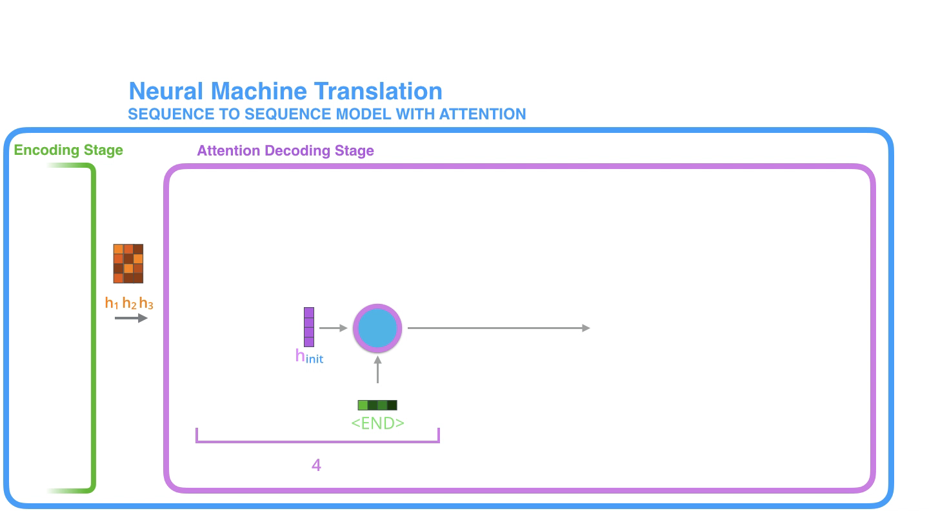
Neural Machine Translation by Jointly Learning to Align and Translate, 2015

Slide 20
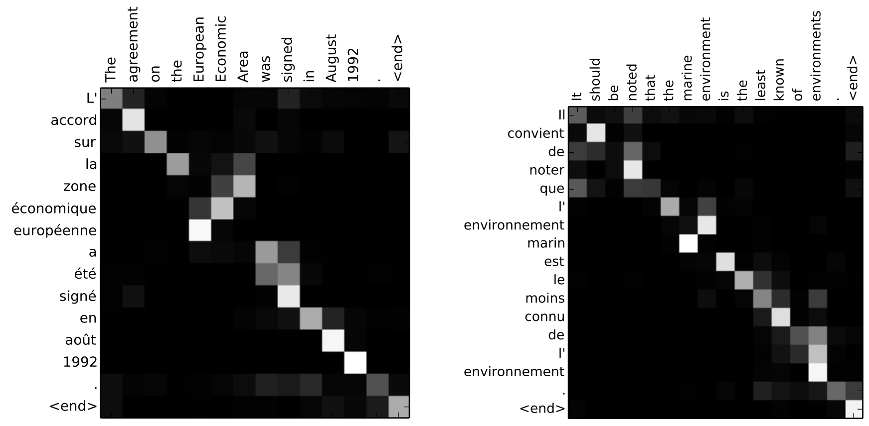
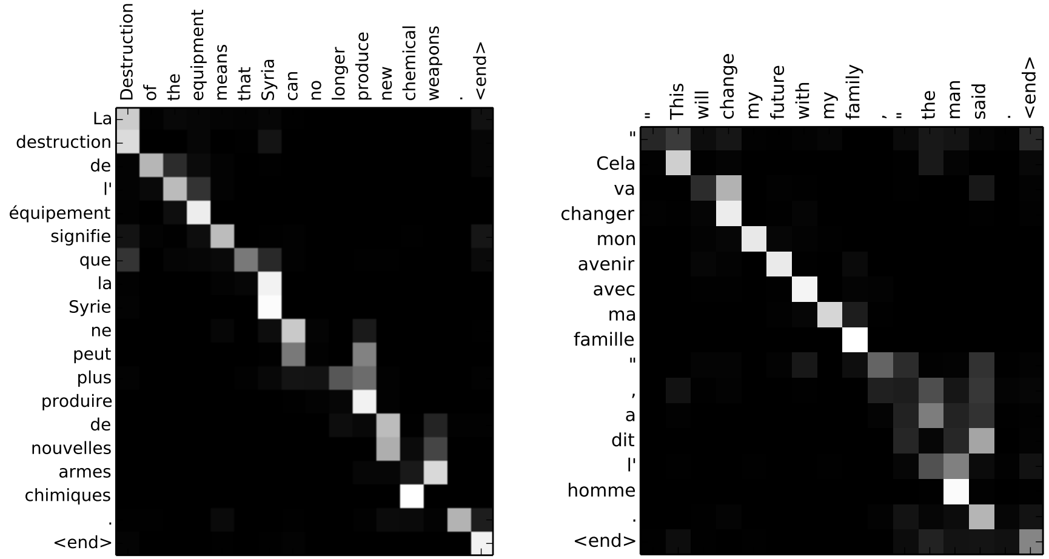
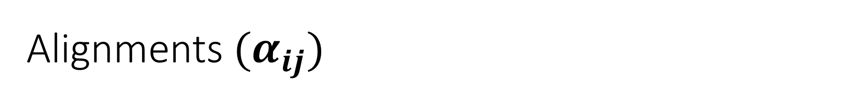
Alignments $(α_{ij})$
Alignment of words between English and French is largely monotonic.
Adjectives and nouns are typically ordered differently between French and English.
[European Economic Area] to [zone´economique europ´een].
Multi-word examples
[The equipment] to [l’ equipement]
Neural Machine Translation by Jointly Learning to Align and Translate, 2015

Slide 21
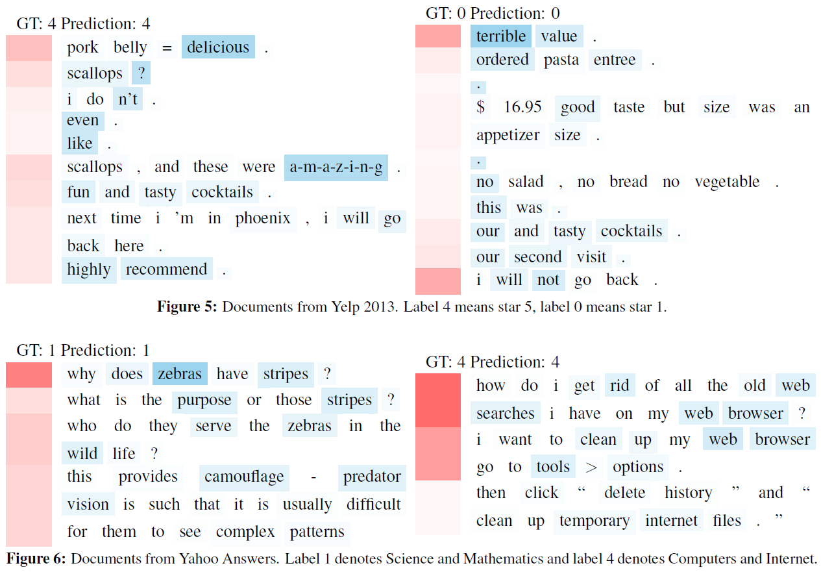
Hierarchical Attention Network (HAN)
Two levels of attention
one at word level and other at sentence level
Figure 5 shows that our model can select the words carrying strong sentiment like delicious, amazing, terrible and their corresponding sentences.
Sentences containing many words like cocktails, pasta, entree are disregarded. Note that our model can not only select words carrying strong sentiment, it can also deal with complex across-sentence context.
For example, there are sentences like i don’t even like scallops in the first document of Fig. 5, if looking purely at the single sentence, we may think this is negative comment.
However, our model looks at the context of this sentence and figures out this is a positive review and chooses to ignore this sentence.
For the left document in Figure 6 with label 1, which denotes Science and Mathematics, our model accurately localizes the words zebra, strips, camouflage, predator and their corresponding sentences. For the right document with label 4, which denotes Computers and Internet, our model focuses on web, searches, browsers and their corresponding sentences.
Yang, Zichao, Diyi Yang, Chris Dyer, Xiaodong He, Alex Smola, and Eduard Hovy. "Hierarchical attention networks for document classification." NAACL, pp. 1480-1489. 2016.

Slide 23
Auto Encoders
Manish Gupta
Visiting Faculty at ISB
Senior Applied Scientist at Microsoft, India
Adjunct Faculty at IIIT-H
Credits: Stanford CS224D course, CS231N Stanford course, Geoffrey Hinton’s course, http://deeplearning.net/tutorial

Slide 24
Agenda
Auto-encoders
Stacked Denoising Autoencoders (SdA)
Deep auto-encoders for document clustering

Slide 25
Agenda
Auto-encoders
Stacked Denoising Autoencoders (SdA)
Deep auto-encoders for document clustering

Slide 26
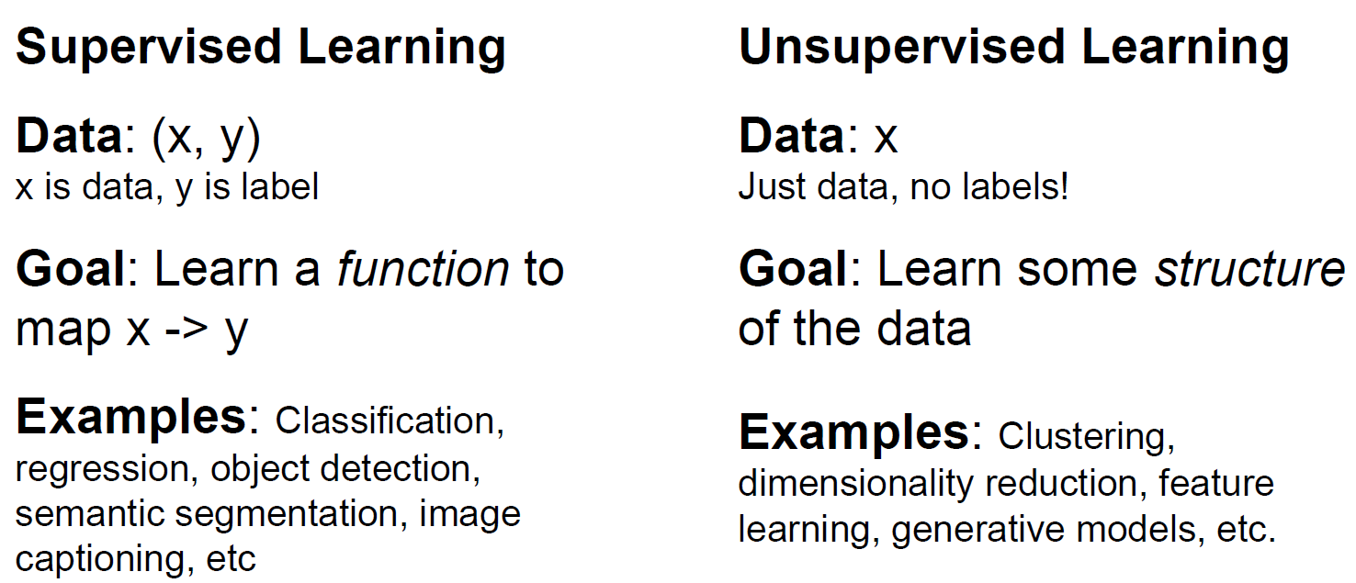
Supervised vs Unsupervised Learning

Slide 27
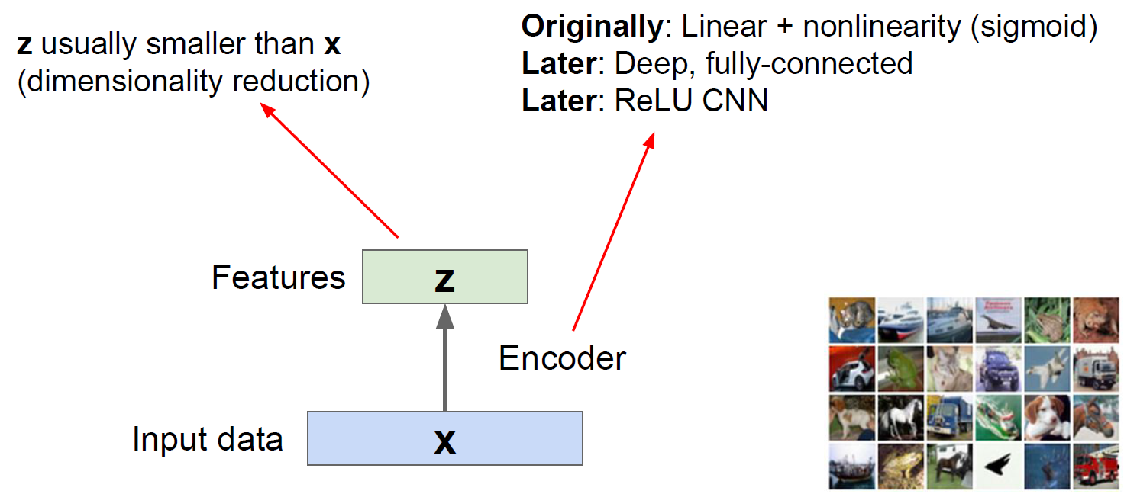
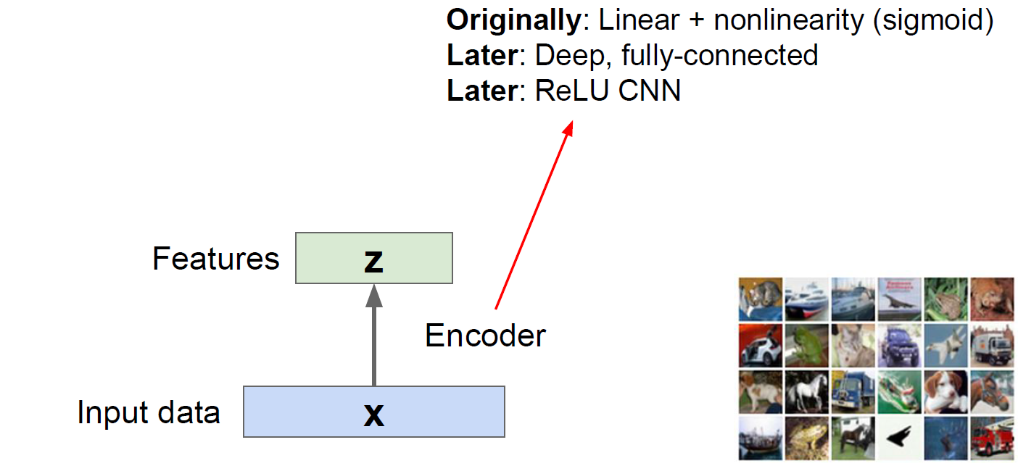
Encoder part of auto-encoder

Slide 28
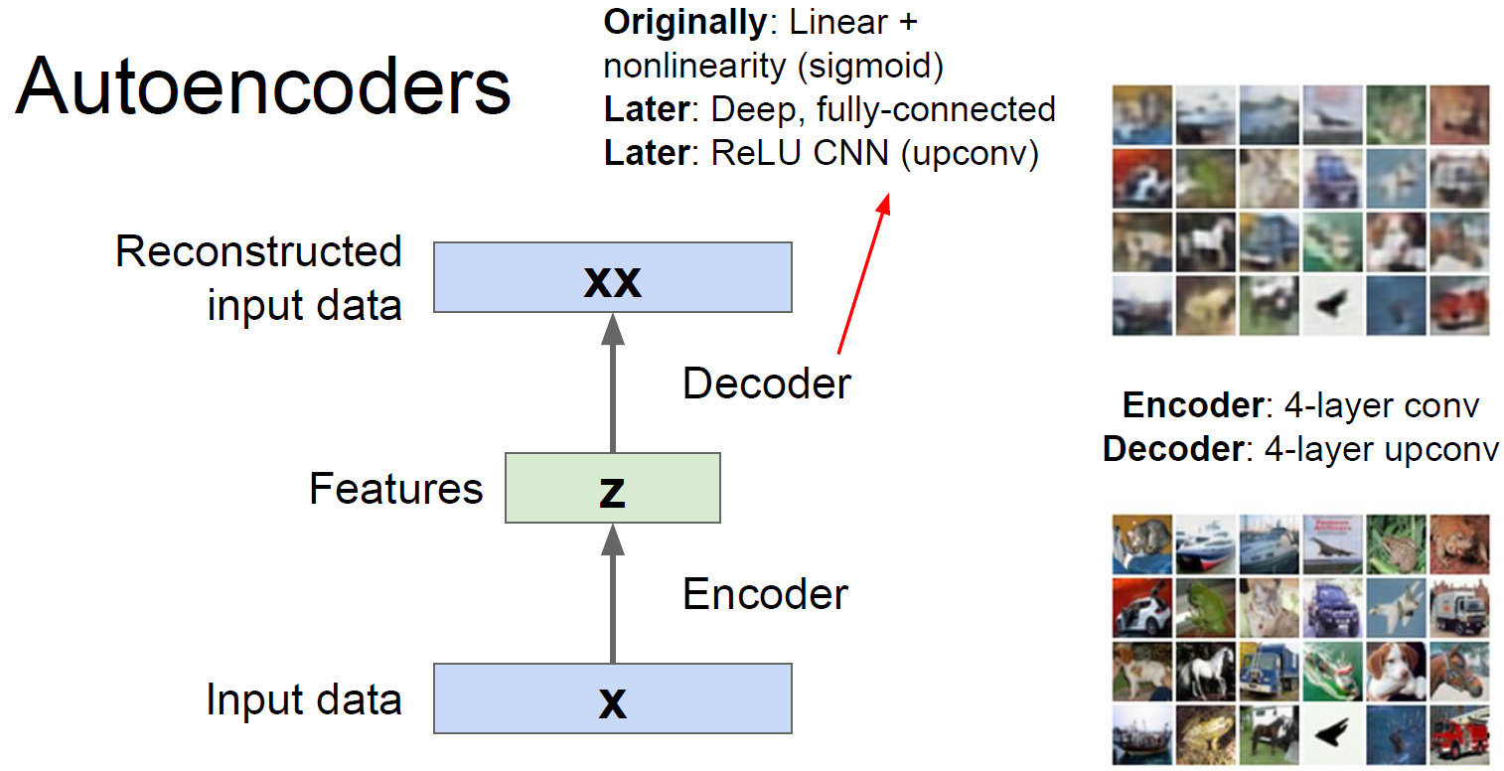
Decoder part of auto-encoders

Slide 29
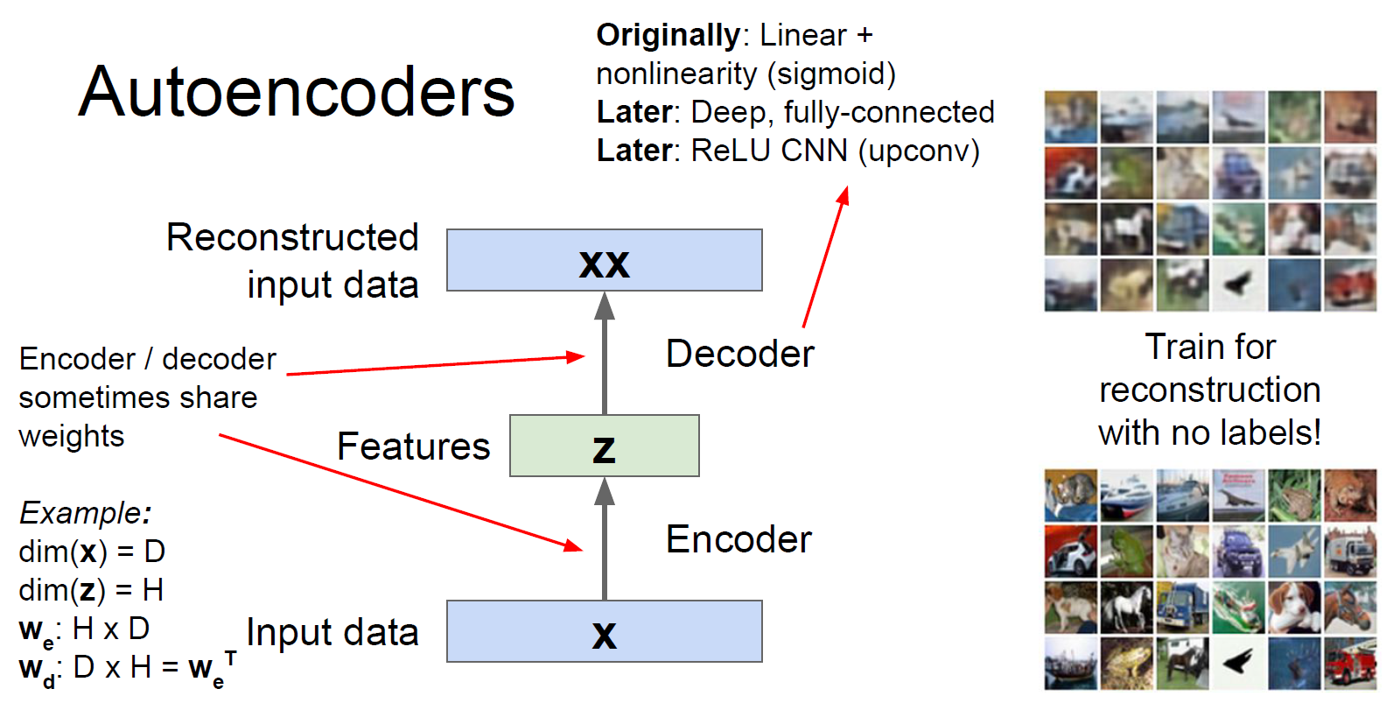

Slide 30
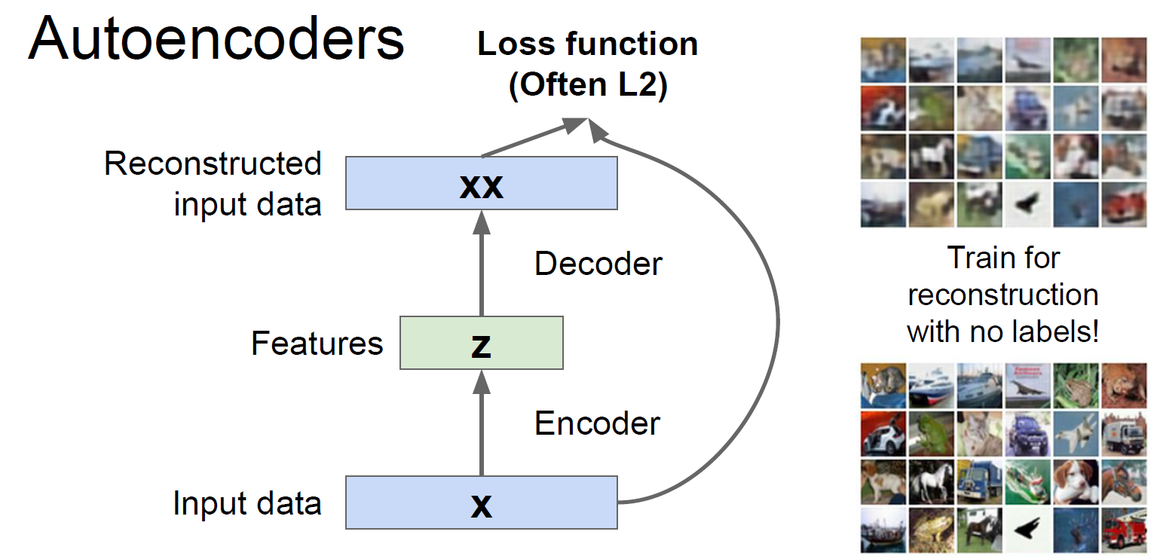

Slide 31
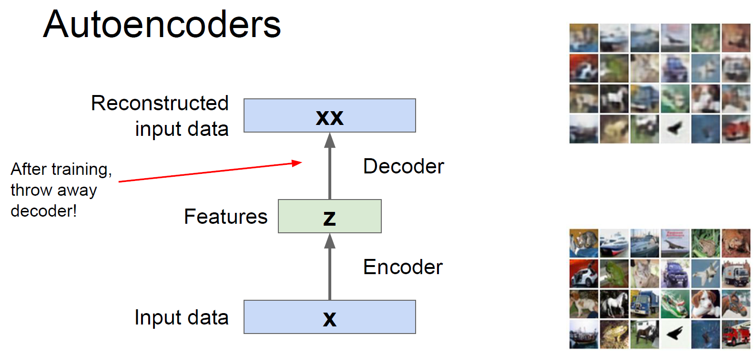

Slide 32
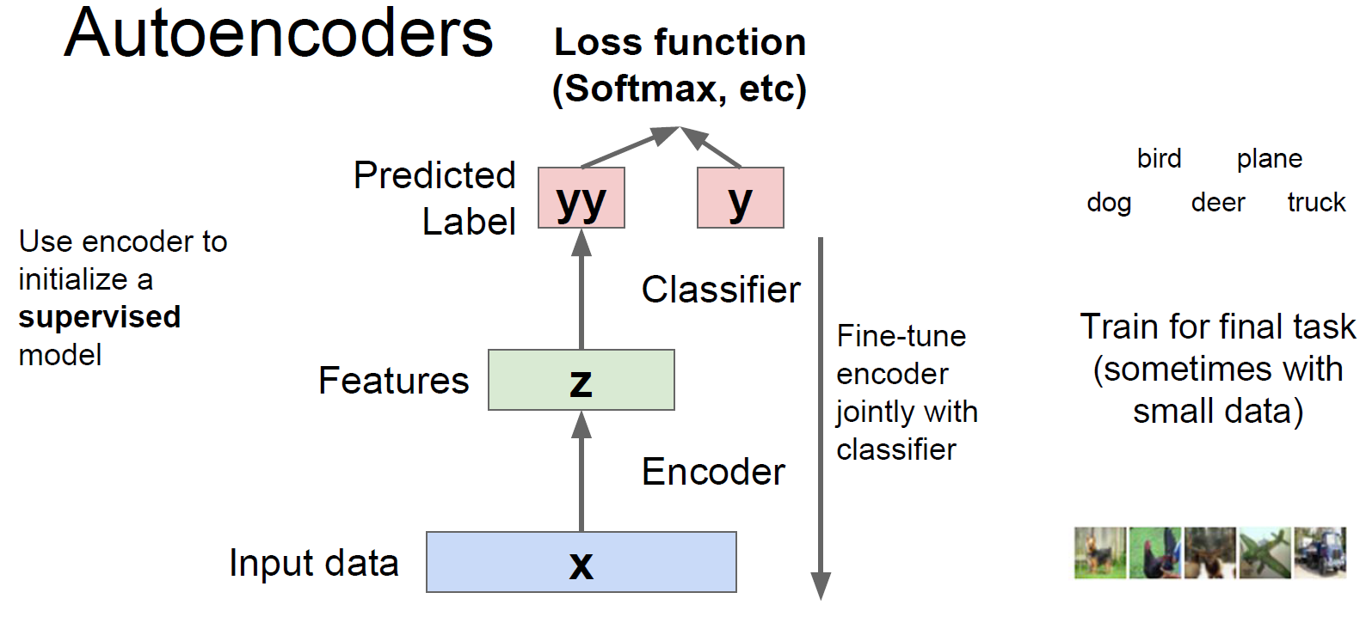

Slide 33
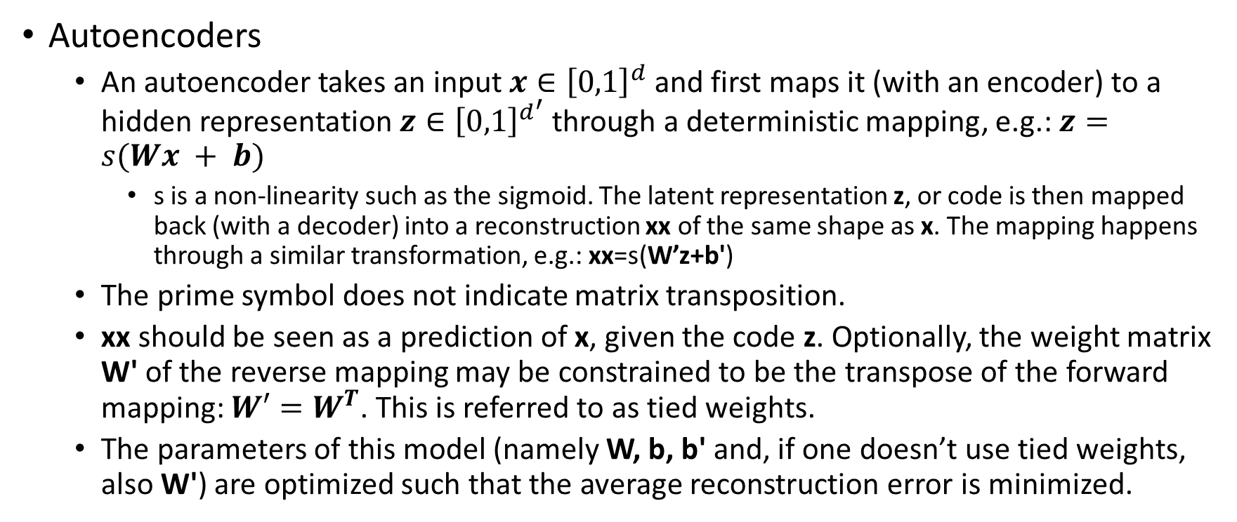
Denoising Autoencoders (dA)
Autoencoders
An autoencoder takes an input $x∈{\left[0,1\right]}^{d}$ and first maps it (with an encoder) to a hidden representation $z∈{\left[0,1\right]}^{d^{′}}$ through a deterministic mapping, e.g.: $z=s(Wx + b)$
s is a non-linearity such as the sigmoid. The latent representation z, or code is then mapped back (with a decoder) into a reconstruction xx of the same shape as x. The mapping happens through a similar transformation, e.g.: xx=s(W’z+b')
The prime symbol does not indicate matrix transposition.
xx should be seen as a prediction of x, given the code z. Optionally, the weight matrix W' of the reverse mapping may be constrained to be the transpose of the forward mapping: $W′=W^{T}$. This is referred to as tied weights.
The parameters of this model (namely W, b, b' and, if one doesn’t use tied weights, also W') are optimized such that the average reconstruction error is minimized.

Slide 34
Denoising Autoencoders (dA)
z captures the coordinates along the main factors of variation in the data just like PCA does.
If there is one linear hidden layer and the mean squared error criterion is used to train the network, then the k hidden units learn to project the input in the span of the first k principal components of the data.

Slide 35
Denoising Autoencoders (dA)
One might expect an auto-encoder with n inputs and an encoding of dimension n (or greater) to learn the identity function.
But when trained with stochastic gradient descent, non-linear auto-encoders with more hidden units than inputs (called overcomplete) yield useful representations.
Stochastic gradient descent with early stopping is similar to an L2 regularization of the parameters.
Addition of sparsity (forcing many of the hidden units to be zero or near-zero).
In order to force the hidden layer to discover more robust features and prevent it from simply learning the identity, we train the autoencoder to reconstruct the input from a corrupted version of it.
A denoising auto-encoder does two things: try to encode the input (preserve the information about the input), and try to undo the effect of a corruption process stochastically applied to the input of the auto-encoder.
The stochastic corruption process randomly sets some of the inputs (as many as half of them) to zero.

Slide 36
Agenda
Auto-encoders
Stacked Denoising Autoencoders (SdA)
Deep auto-encoders for document clustering

Slide 37
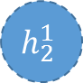
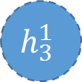
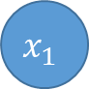
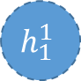

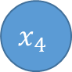


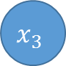

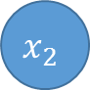

Stacking auto-encoders
Train the first layer of auto-encoder like we did earlier
$$x_{1}$$
$$\hat{x_{1}}$$
$$h_{1}^{1}$$
$$x_{2}$$
$$\hat{x_{2}}$$
$$h_{2}^{1}$$
$$x_{3}$$
$$\hat{x_{3}}$$
$$h_{3}^{1}$$
$$x_{4}$$
$$\hat{x_{4}}$$
1
$$1$$
Input
Features 1
Reconstruction

Slide 38

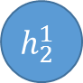
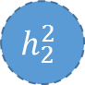
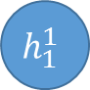
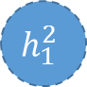
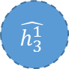
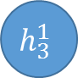

Stacking auto-encoders
Train the second layer
Treat the encoded version i.e. output of first layer as input, and learn an auto-encoder with more abstract features
$$h_{1}^{1}$$
$$\hat{h_{1}^{1}}$$
$$h_{2}^{1}$$
$$\hat{h_{2}^{1}}$$
$$h_{1}^{2}$$
$$h_{3}^{1}$$
$$h_{2}^{2}$$
$$\hat{h_{3}^{1}}$$
1
$$1$$
Input
Features 1
Features 2
Reconstruction

Slide 39
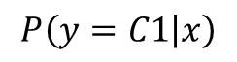
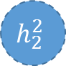
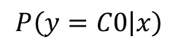
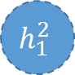

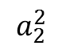
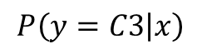
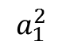
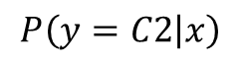
Stacking auto-encoders
$$P\left(y=C0 | x\right)$$
Consider soft-max classifier, say to classify document in 4 classes, C0 to C3
$$a_{1}^{2}$$
$$P\left(y=C1 | x\right)$$
$$h_{1}^{2}$$
$$a_{2}^{2}$$
$$P\left(y=C2 | x\right)$$
$$h_{2}^{2}$$
$$P\left(y=C3 | x\right)$$
$$1$$

Slide 40
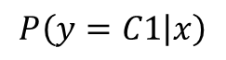

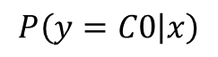


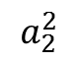
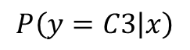
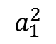
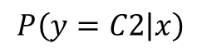
Stacking auto-encoders: the full network
Next: fine tune
Run back-propagation on this network to optimize it further
$$x_{1}$$
$$P\left(y=C0 | x\right)$$
$$h_{1}^{1}$$
$$x_{2}$$
$$a_{1}^{2}$$
$$P\left(y=C1 | x\right)$$
$$h_{1}^{2}$$
$$h_{2}^{1}$$
$$P\left(y=C2 | x\right)$$
$$x_{3}$$
$$a_{2}^{2}$$
$$h_{2}^{2}$$
$$h_{3}^{1}$$
$$P\left(y=C3 | x\right)$$
$$x_{4}$$
$$1$$
1
$$1$$
Input
Features 1
Features 2
Soft-max

Slide 41
Agenda
Auto-encoders
Stacked Denoising Autoencoders (SdA)
Deep auto-encoders for document clustering

Slide 42
How to find documents that are similar to a query document
0 0 2 2 0 2 1 1 0 0 2
fish cheese vector count school query reduce bag pulpit iraq word
Convert each document into a “bag of words”.
This is a vector of word counts ignoring order.
Ignore stop words (like “the” or “over”)
We could compare the word counts of the query document and millions of other documents but this is too slow.
So we reduce each document vector to a much smaller vector that still contains most of the information about the content of the document.

Slide 43
How to compress the count vector
output vector
2000 reconstructed counts
We train the neural network to reproduce its input vector as its output
This forces it to compress as much information as possible into the 10 numbers in the central bottleneck.
These 10 numbers are then a good way to compare documents.
500 neurons
250 neurons
10
250 neurons
500 neurons
input vector
2000 word counts

Slide 44

First compress all documents to 2 numbers using PCA on log(1+count). Then use different colors for different categories.

Slide 45

First compress all documents to 2 numbers using deep auto. Then use different colors for different document categories

Slide 46
What we did not talk about …
Recursive neural networks: model structured outputs. Learn hierarchies and trees.
Deep learning for chatbots
Deep reinforcement learning
RBMs (Restricted Boltzmann Machines) and DBNs (Dynamic Bayesia Networks)
Memory networks
GANs: Generative Adversarial Networks
Transformer based networks: BERT, MT-DNN, XLNet, T5, …
Graph Neural Networks
Video analytics using deep neural networks
Model compression
Model Interpretation – e.g., GradCAM (Gradient-weighted Class Activation Mapping)

Slide 47
Take-aways
Deep SL
Multi-Layer Perceptron (MLP)
Convolutional NN
Recurrent Neural Net (RNN) / Long short-term memory (LSTM)
Attention based models
Deep UL
Denoising Auto-encoder (DA) and Stacked DA
Notes:
I will give a quick tutorial to cover, as much as I can, state-of-the-art DSL and DRL methods. Then I will ask Li to lead the discussion on how we leverage all these methods to build an AGI engine for MS so as to build an intelligent conversation platform to support Bing Next scenarios.
Let us start with DSL. I will present a list of ML/NLP tasks, and for each I introduce the best DL models. E.g.,

Slide 48
Further Reading
Deep learning one-stop website (tutorials/books/jobs/code/research groups)
http://deeplearning.net
Comprehensive one-stop resource for all NN related work
http://deeplearning.net/reading-list/tutorials/
Good Introductory Tutorial on Artificial Neural Networks
http://web.iitd.ac.in/~sumeet/Jain.pdf
A Brief Introduction to Neural Networks
http://www.dkriesel.com/en/science/neural_networks
Recent tutorials
Deep Learning tutorial at NIPS’2015
Reinforcement Learning tutorial at NIPS’2015

